Slide 1
Border Crossing Presentation
James Ransom
Mohawk Council of Akwesasne
April 22, 2015

Slide 2
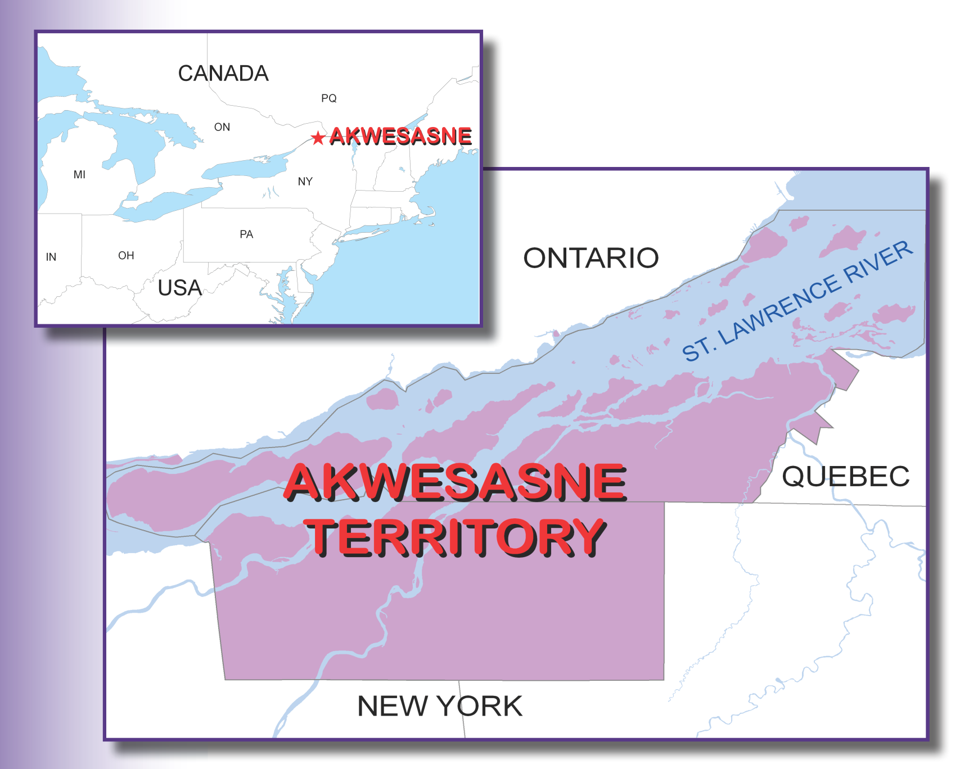
Notes:
Mention uniqueness of Akwesasne, situated in two countries, two provinces and one state. Akwesasne is where Ontario, Quebec, and New York State come together along the St. Lawrence River. Three Mohawk governments: MCA, SRMT, and MNCC. Membership: 12,000 for MCA, 13,000 for SRMT, thousands for the MNCC.

Slide 3
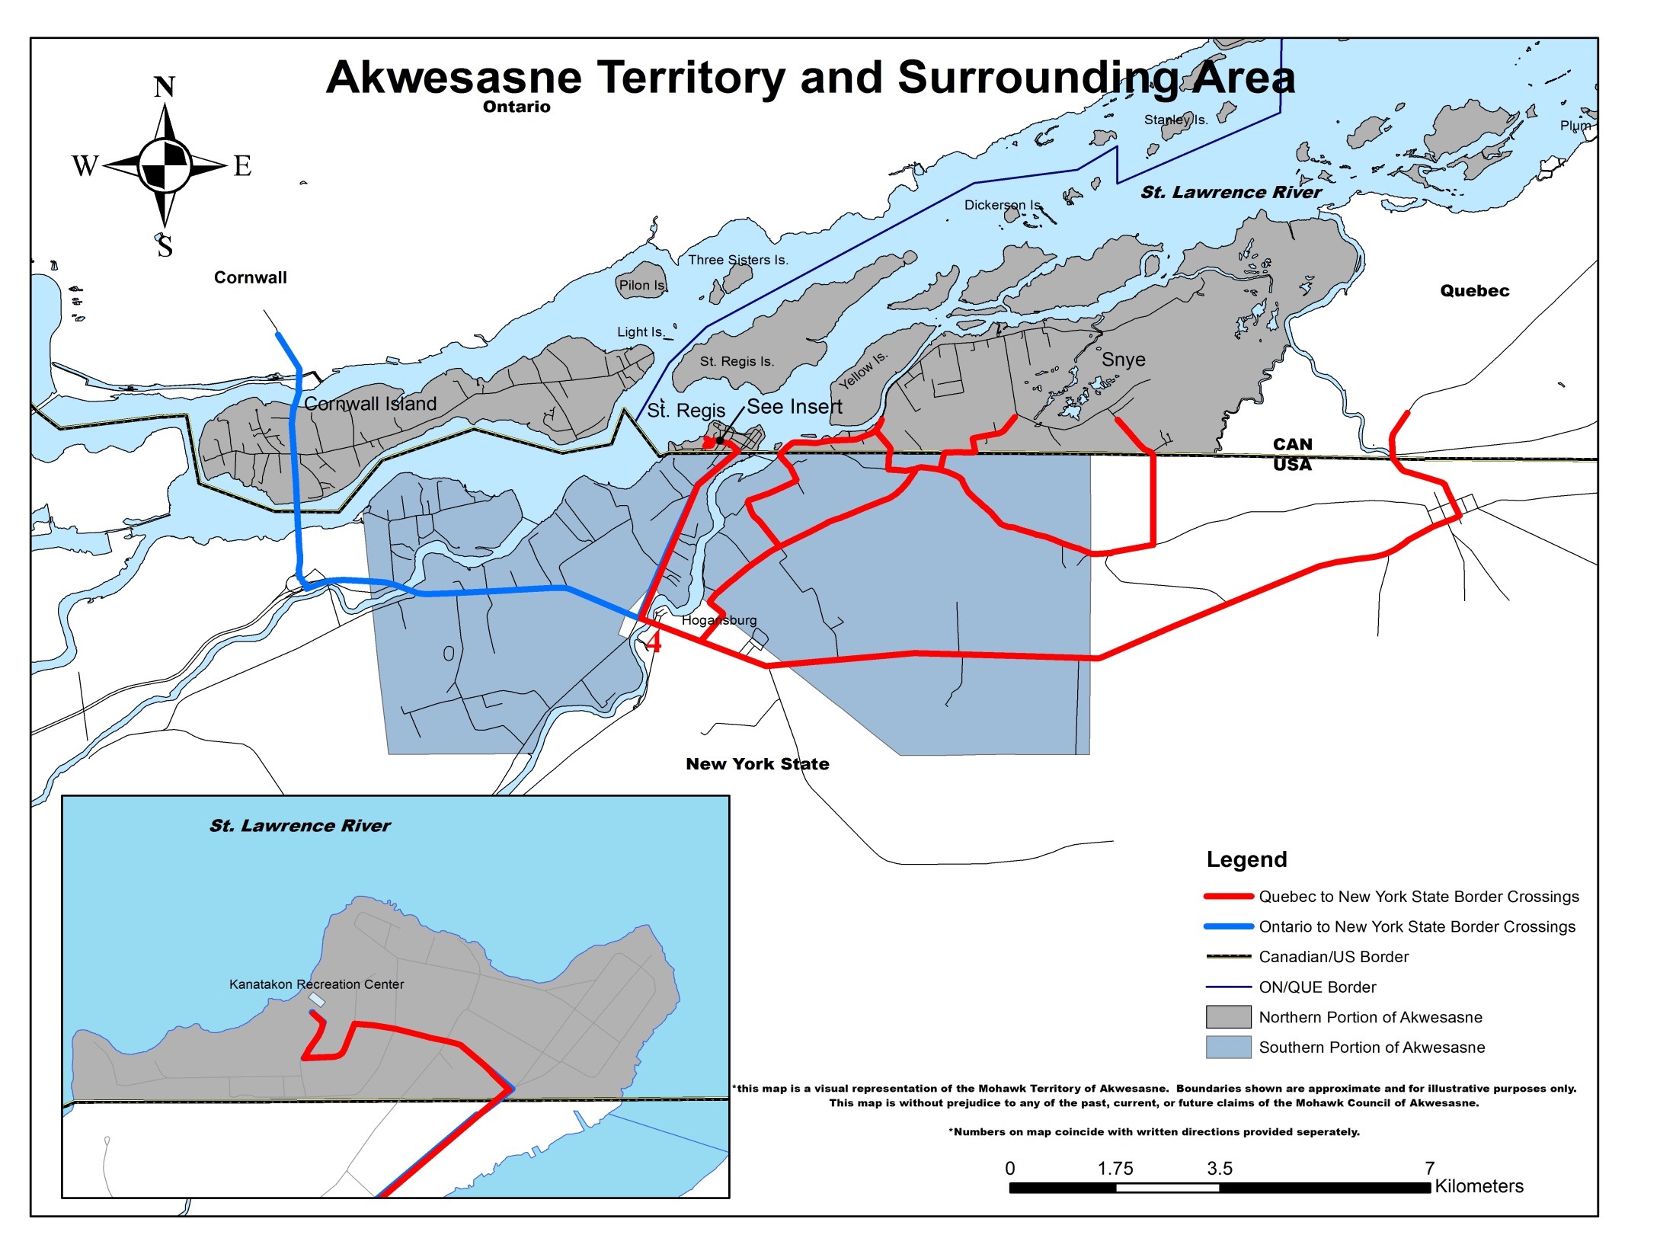
Notes:
Map shows international nature of community. Three separate MCA Districts, two in Quebec, one in Ontario, one in New York. River landlocks the community from Canada. Map shows the two closest entry points into Canada from Akwesasne for the Kanatakon district. St. Lawrence River land locks the community from the rest of Canada.

Slide 4
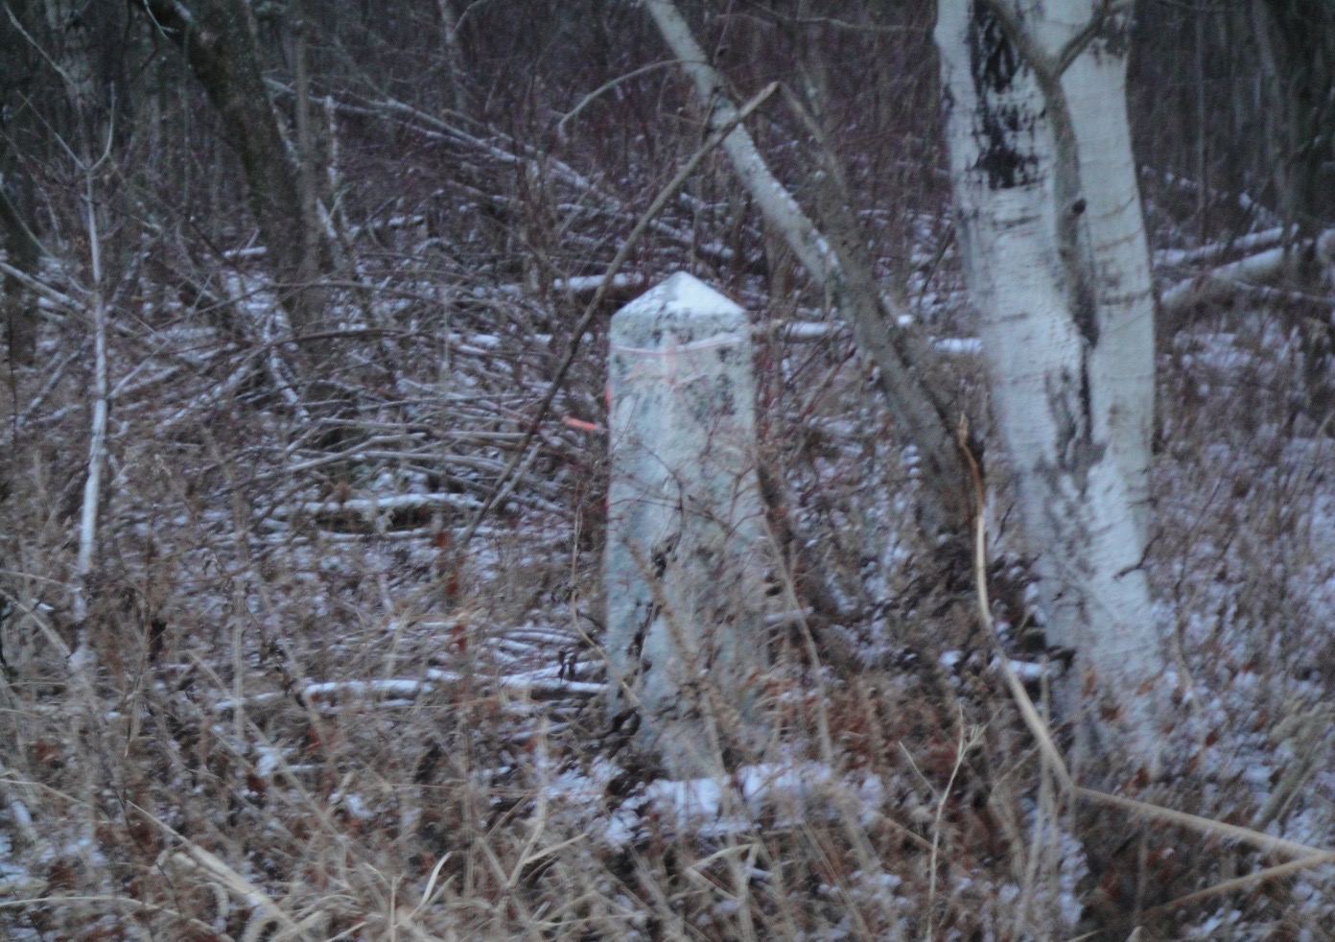
Tsi Snaihne Border Crossing
Notes:
There are only two ways to know that you have entered the Tsi Snaihne District. This border marker is along the roadway. The other way is that the pavement is different once you enter the district from the United States.

Slide 5
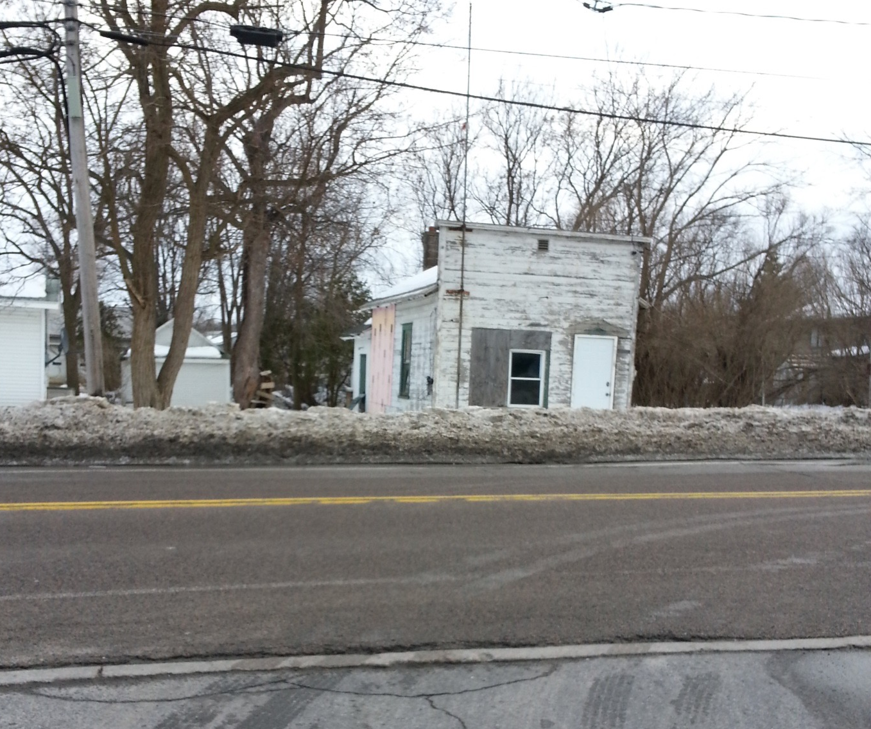
Kanatakon: Former US Customs
Notes:
This is the former US Customs on St. Regis Road. It was operated up through the 1960s. Travelers coming from Kanatakon reported here. Many times the US custom’s officer would have to be woken up so people could report. Once it was closed, there was no longer a reporting requirement from the US for Akwesasne’s residents leaving the district.

Slide 6
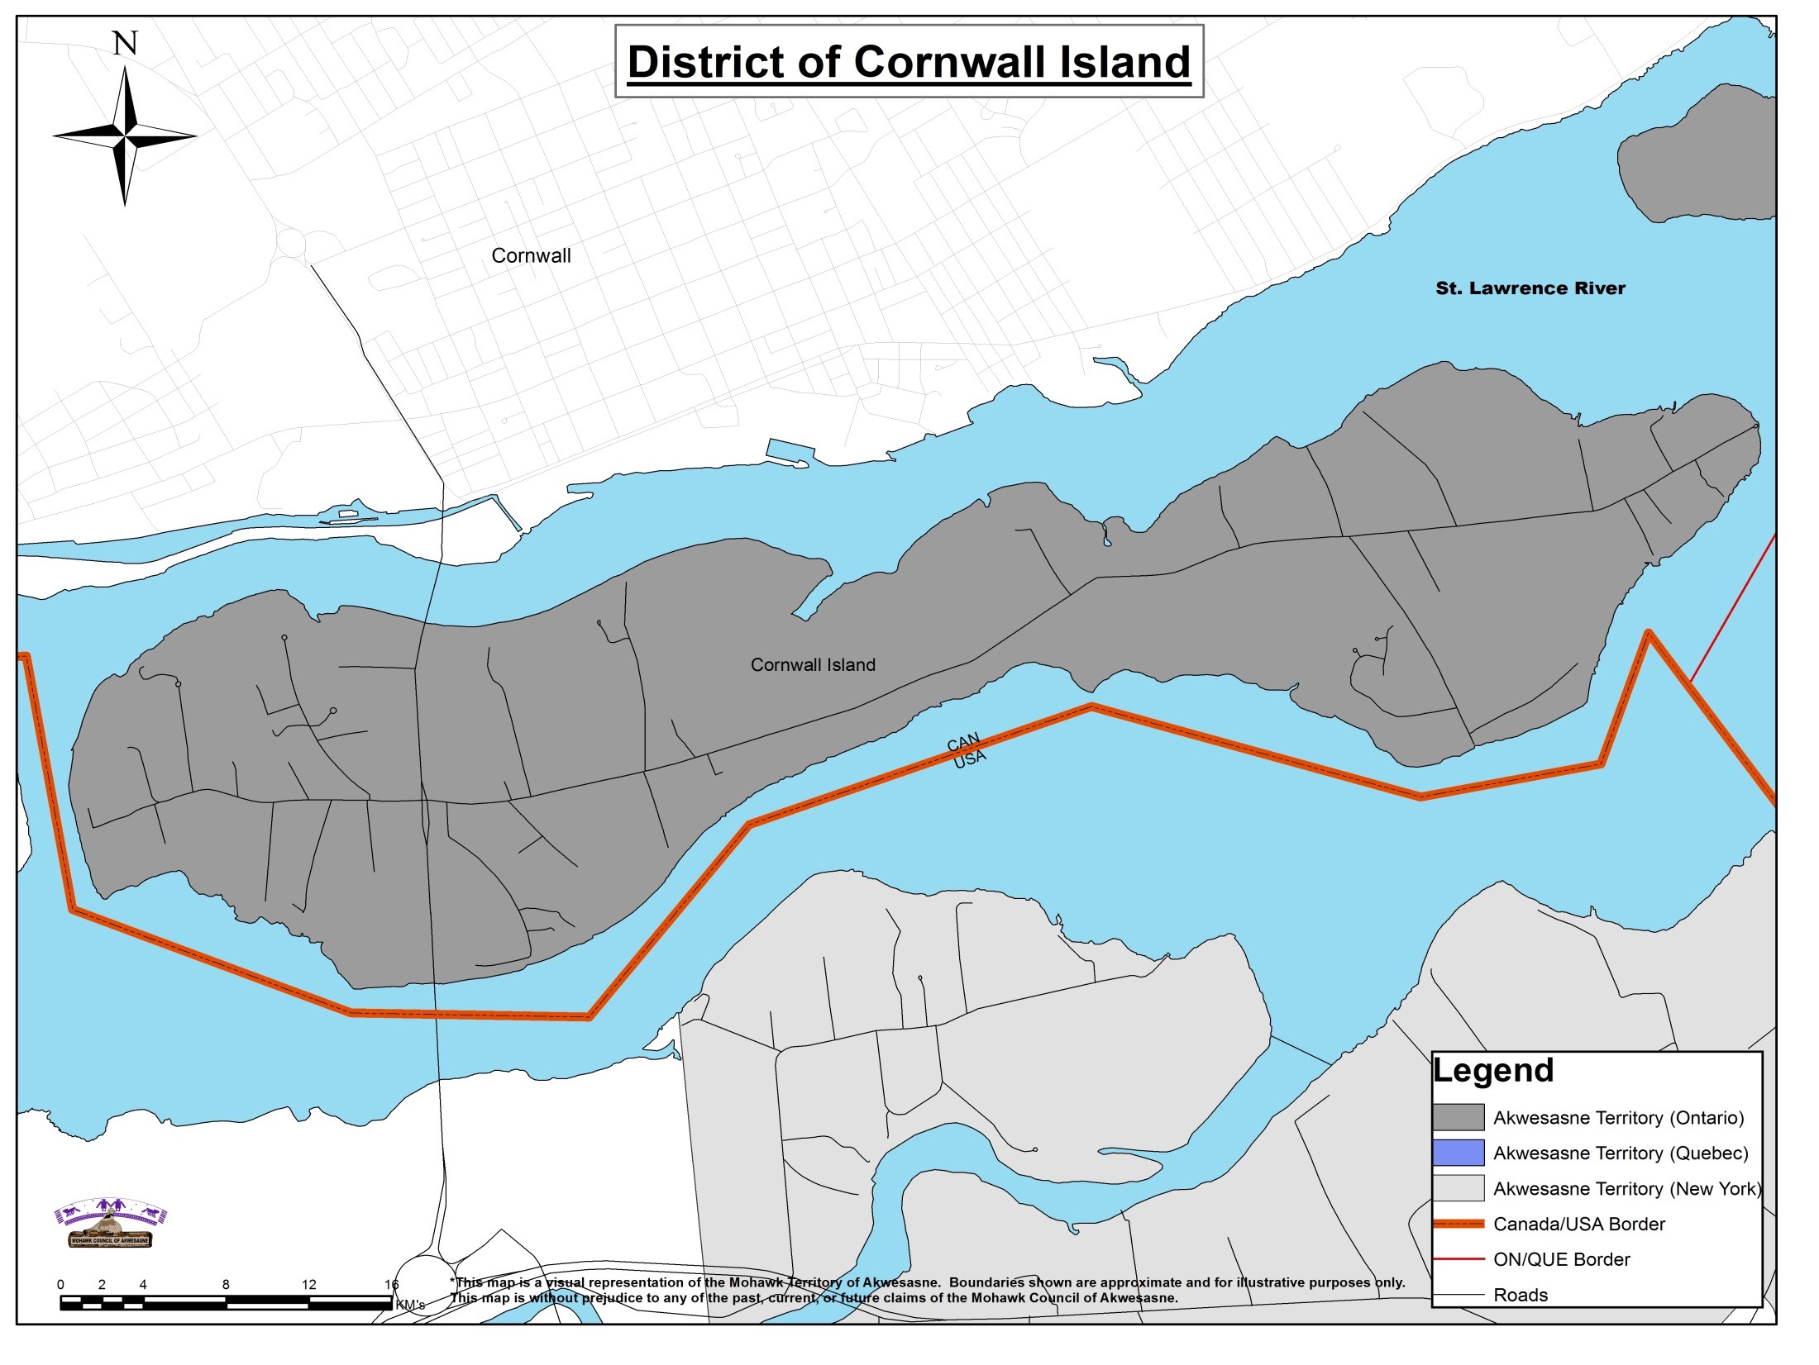
Notes:
Kawehno:ke district. International 3 Nations Bridge Corridor travels through this District. A’nowara’ko:wa Arena is in the district. All Mohawks except for school buses and emergency vehicles have to report to Cornwall first before going to the Island. Cemetery for Traditional people is on the island but the Longhouse for the burial ceremonies is on the US side of Akwesasne. All Mohawks going to other districts must report at US Customs. Families can buy their groceries in Canada. Twenty minutes to forty minutes to go to other districts.

Slide 7
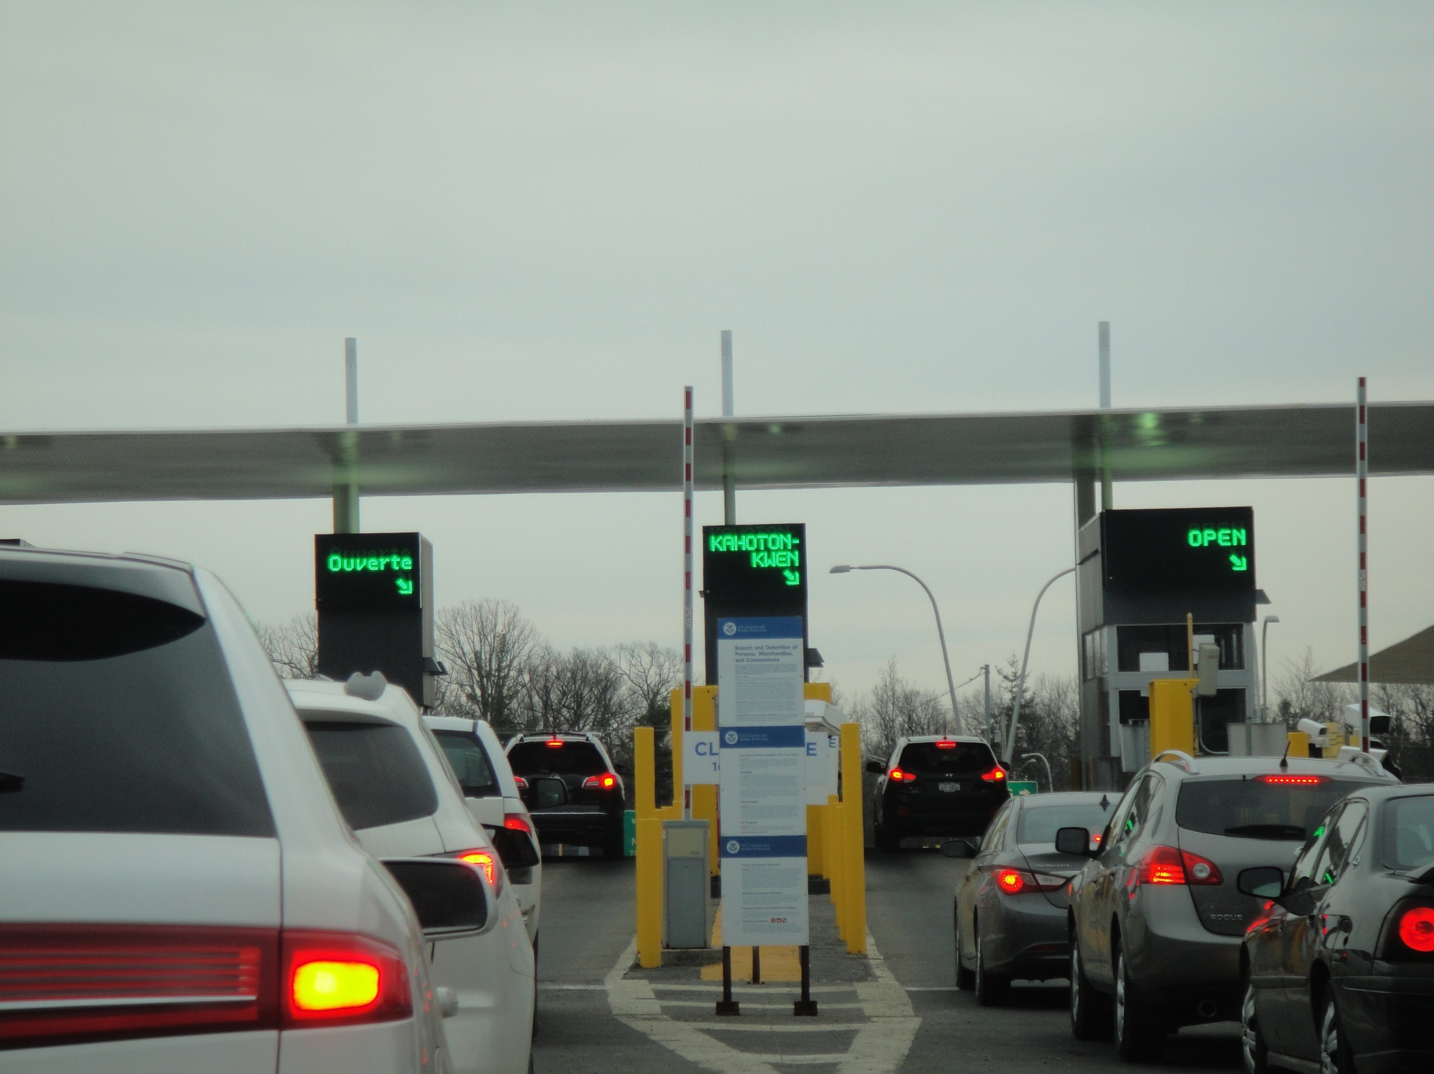

Slide 8
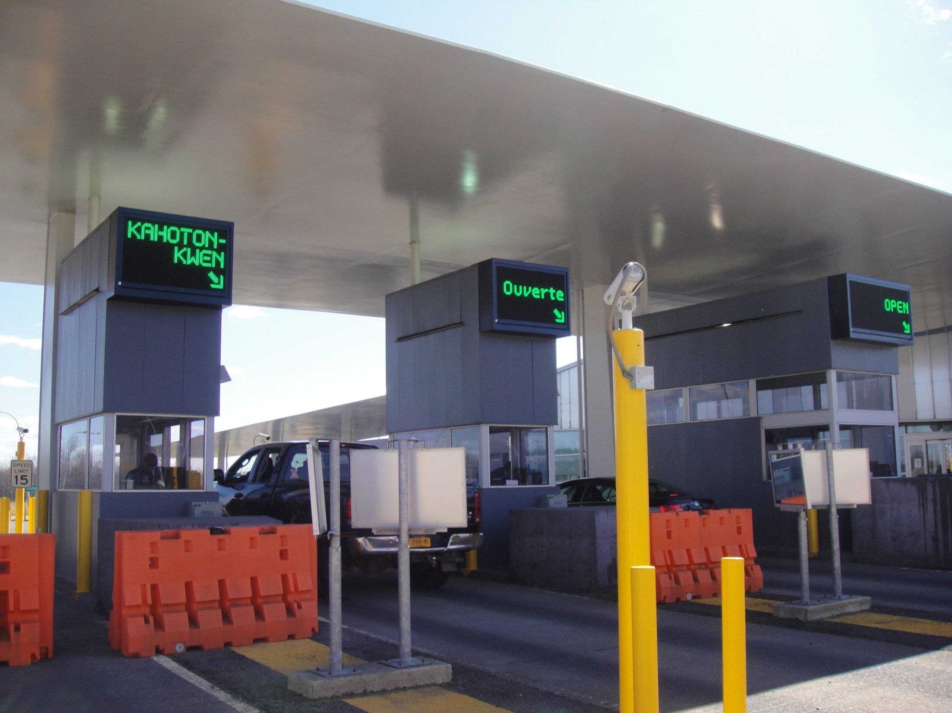

Slide 9
Aboriginal Right to Mobility
Ms. Alicia Shenandoah and her Children
Ms. Thompson faced criminal charges for not reporting immediately to the port of entry
She was deported for not having Registered Status Identification and therefore not establishment as a resident or citizen of Canada
Notes:
She is facing additional charges for failure to provide identification; and false identification.

Slide 10
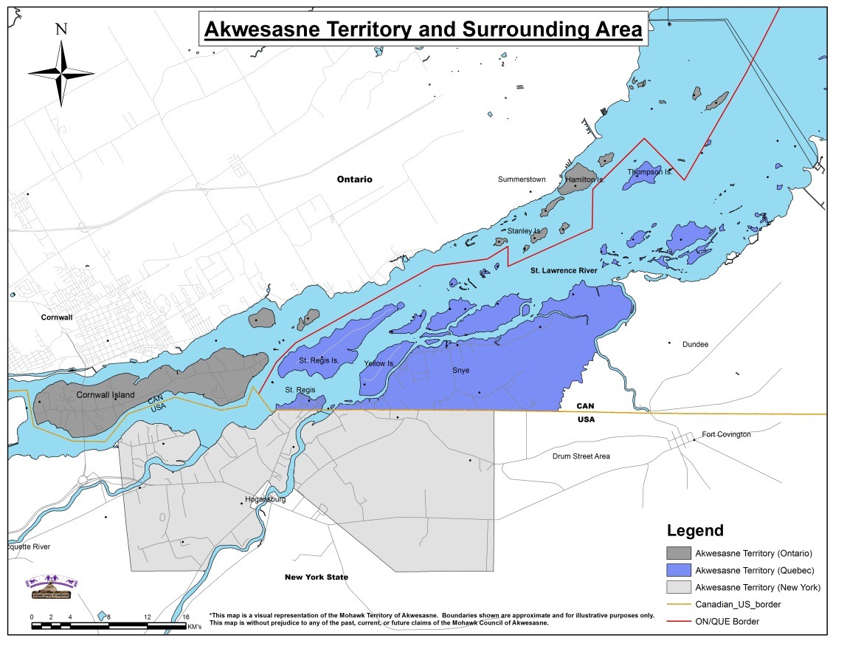
Border Crossing Solutions
Three Nations Bridge Border Crossing
· 10th busiest border crossing
· 2.2 million vehicles annually
· 70% Mohawk
Issue 1: Not recognizing Akwesasne’s border crossing rights.
Mohawk Proposal: Canada honor the Jay Treaty.
Issue 2: Not accommodating Akwesasne’s request for an alternative reporting mechanism for Mohawk in their own community.
Mohawk Proposal: Development of AKPASS Reporting System.
Issue 3: Not accommodating Akwesasne’s request for development and recognition of a secure identification card.
Mohawk Proposal: Development of Mohawk Secure Identification Card.
Issue 4: Not relocating the Seaway International Bridge Corporation’s Toll Booth to the base of the south span of the bridge to the United States.
Mohawk Proposal: Relocate Toll Booth to South Span Location. Contract with Mohawks to operate Toll Booth.

Slide 11
Akwesasne’s Economy
$140 Million Economy.
$107 Million Leaked.
22% Unemployment Rate.
2,500 youth entering workforce over the next ten years.
Creating Economic Development Corporation
Creating Mohawk Electric Cooperative

Slide 12
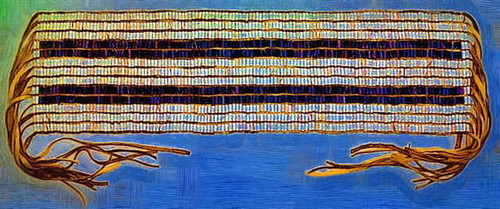
The First NAFTA The Two Row Wampum

Slide 13
MCA Trade Agreements
Huron Wendat Nation of Wendake – Quebec
Maya Q’eqchi – Guatemala
West Bank – British Columbia
Kahnawake and Kahnasatake – Quebec
Metis of Labrador - Labrador

Slide 14
Tribal – First Nation Trade Agreements
Preamble
Principles to Guide Relationship
Purpose – Common Interests
Areas of Coverage
Dispute Resolution
Amendments
Signatories

Slide 15
Questions?
For more information, contact the Department of Tehotiiennawakon:
James W. Ransom, Director
Department of Tehotiiennawakon
Mohawk Council of Akwesasne
Box 579
Cornwall, Ontario K6H 5T3
(613) 936-1548

