Slide 1
www.edo.ca
Excellence in Aboriginal Economic Development

Slide 2
Mission & Vision
In 1990, EDOs from across Canada founded and mandated Cando to become a national body to focus on the training, education and networking opportunities necessary to serve their communities and/or organizations as professionals.
Cando’s mission:
is to build capacity which strengthens Aboriginal economies by providing programs and services to Economic Development Officers (EDOs).
Cando’s vision:
is to be the leading authority on Aboriginal Community Economic Development.

Slide 3
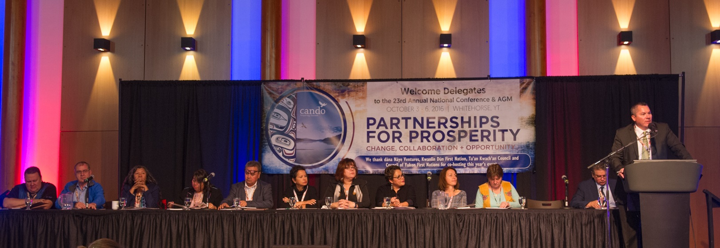
Cando Board of Directors

Slide 4

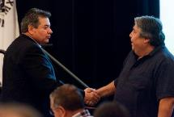
Cando
Provides professional support to Aboriginal Economic Development Officers. Aboriginal-controlled, community-based, membership-driven, non-profit organization. To provide training, networking, partnerships, and educational opportunities for Aboriginal EDOs across Canada that potentially leads to strong, vibrant, self-reliant communities.
Cando has been instrumental in facilitating partnerships with EDOs, academics, Aboriginal leaders and senior corporate and government representatives.
Cando is unique because it is the only national organization that focuses on education and professional development for EDOs working in Aboriginal communities or organizations.

Slide 5
Aboriginal Economic Developer Process
The first national professional certification process designed, developed and facilitated by an Aboriginal organization.
Relevant
was developed through the DACUM (Developing a Curriculum) Process to identify the core competencies and to ensure the content was relevant to the field of Aboriginal economic development.
Accessible
recognizes Prior Learning Assessment (PLA) through the individual assessment process, you should not have to return to school for what you've already learned.
Affordable
admission fees are very reasonable, and we provide reference to a scholarship that may be available to you.
Certified
recognized by post-secondary institutions, Corporate Canada, and Aboriginal leadership.

Slide 6
Technician Aboriginal Economic Developer (TAED) Level
Aboriginal Law and Policies
Organizational and Financial Management
Governance and Leadership
Economics
Sustainable Environment and Land Stewardship
Lands and Resource Management
Project Management
Community Planning and Development
Community Based Economic Development
Contemporary Aboriginal Economic Development
Aboriginal Business Development and Entrepreneurship

Slide 7








Accredited Post Secondary Partners

Slide 8
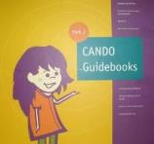
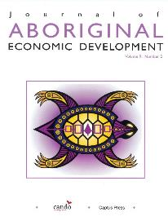
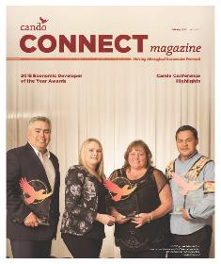
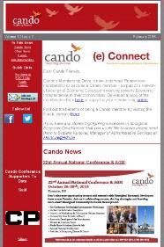
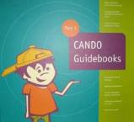
Tools & Resources

Slide 9
Tools & Resources
Cando Guidebooks contain valuable tools to help Aboriginal Economic Development Officers in their day-to-day work. Learn more about CED philosophy and theory, see the CED community checklists, models of CED, CED tools and processes and other tools and processes.
The only journal of its kind in Canada, the Journal of Aboriginal Economic Development provides a view of economic development from a uniquely Aboriginal perspective. Published jointly by Cando and Captus Press.
Cando Connect Magazine is a quarterly publication that is distributed to Cando members and Aboriginal communities across Canada. The magazine contains updates about Cando, current events, EDO success stories and recent developments and news related to Aboriginal economic development.
The Cando (e) Connect Newsletter is a monthly electronic publication that reaches over 1,800 subscribers across the country. The newsletter features updates on Cando’s training and certification, EDO of the month section, employment opportunities, current events and national news.

Slide 10
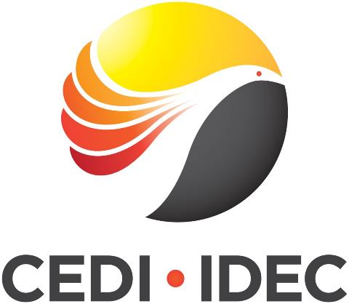

Slide 11
What is CEDI?
The First Nations - Municipal Community Economic Development Initiative (CEDI)
The First Nations - Municipal CEDI is a joint initiative of the Federation of Canadian Municipalities (FCM) and Cando that builds the capacity of First Nations and adjacent municipalities to develop joint community economic development (CED) plans and strategies.
From 2013-2016, CEDI worked with six partnerships of First Nations and municipalities across Canada to enhance their community-to-community relationships and collaboration on joint CED initiatives as part of Phase I. By the end of the Phase I, all six partnerships have developed a strategy to move forward within joint economic development and have built a formal relationship protocol to help initiatives move forward.

Slide 12
What is CEDI?
Phase II of the CEDI Project will run from 2016-2021 and will work with 10 partnerships. The Phase II will be carried out in 3 cycles: from over 80 applications, 4 partnerships will be selected in 2016, 3 partnerships in 2017, and 3 more partnerships in 2018.
Partnerships selected for cycle 1 are:
Enoch Cree Nation & City of Edmonton, Alberta
Battleford Agency Tribal Council & City of North Battleford, Saskatchewan
Paqtnkek Mi’kmaw Nation & County of Antigonish, Nova Scotia
Fort William First Nation & City of Thunder Bay, Ontario

Slide 13
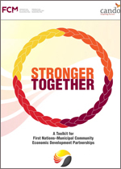
What is CEDI?
CEDI has developed Stronger Together, a Toolkit for joint First Nations - municipal CED planning that contains a guide, tools, case studies and other resources for First Nations and municipal staff and elected officials interested in improving their community-to-community relationship and undertaking joint First Nations - municipal CED planning in their own regions. The resources are updated regularly – the most recent being a guide to financial resources available across the country for collaborations.
The Toolkit is available online at http://www.fcm.ca/home/programs/community-economic-development-initiative/our-toolkit-and-more-resources.htm.

Slide 14
Coming Together

Slide 15
Cando Annual National Conference & AGM
Cando’s conferences provide Economic Development Officers (EDOs) with tools and resources to discover new opportunities for community economic development in Aboriginal regions and communities throughout Canada.
The conference will be of interest to all, from the beginner Aboriginal community economic developer to the advanced practitioner.
We will examine urban, rural and remote challenges; and offer exposure to diverse perspectives including First Nation, Métis and Inuit, and showcase entrepreneurial approaches in Aboriginal economic development.

Slide 16
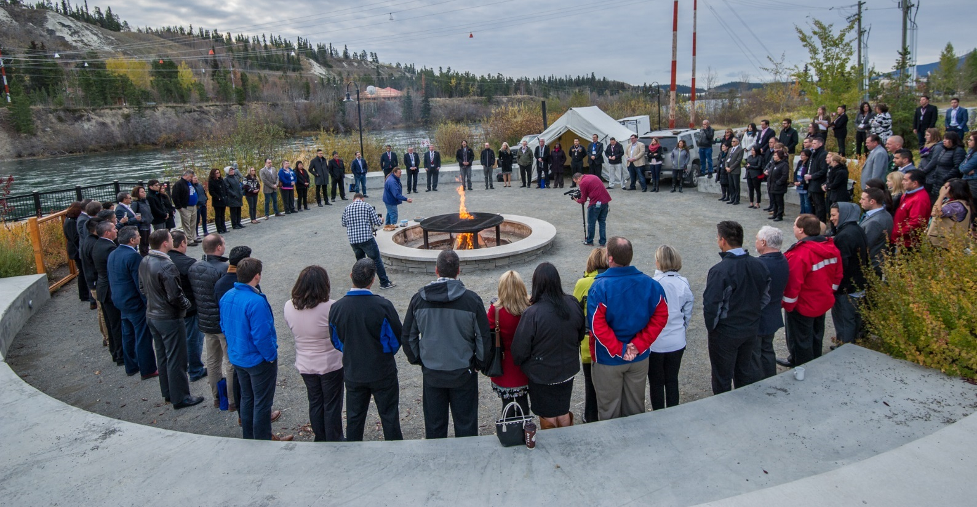
22rd Annual National Conference & AGM Whitehorse, Yukon

Slide 17
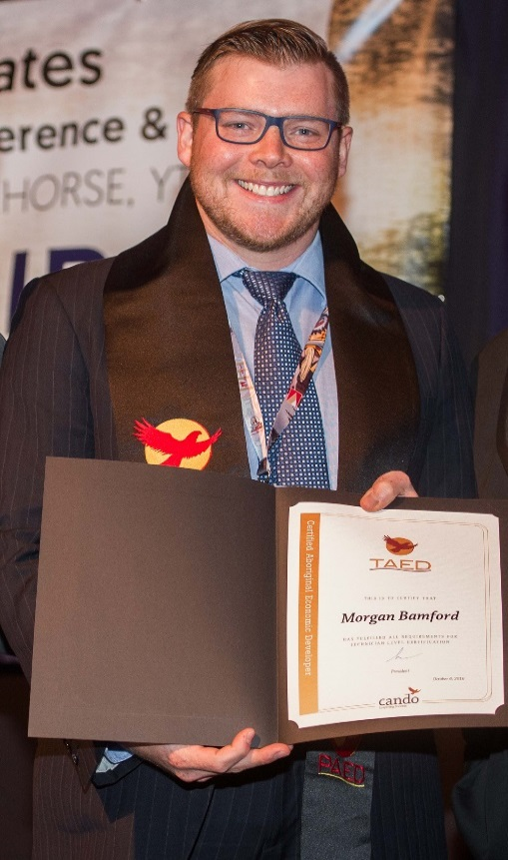


23rd Annual National Conference & AGM
Certified Aboriginal Economic Developer Recognition Ceremony
10 TAED & 2 PAED Graduates in 2016

Slide 18
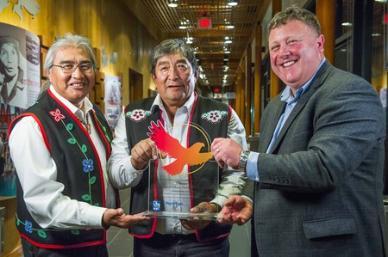
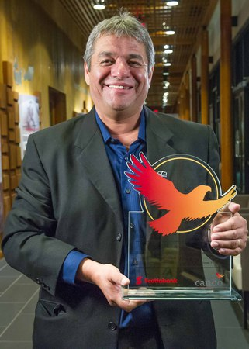
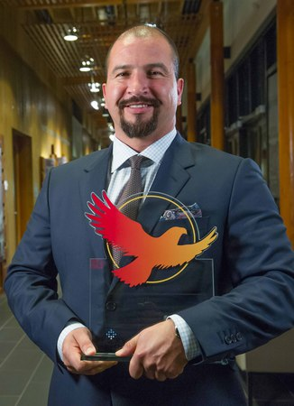
22nd Annual National Conference & AGM
2016 Economic Developer of the Year Award Winners
L-R: Eric Morris, Richard Sidney, & Gord Curran, Teslin Tlingit Council & Village of Teslin; Rob Crow, Blood Tribe Economic Development; and Chris Wilson, Birch Mountain Enterprises Credit: Archbould Photography

Slide 19
23rd Annual National Conference & AGM
2016 ED of the Year Award Winners
Teslin Tlingit Council & Village of Teslin, YT - Community Category
Rob Crow, AB - Individual EDO Category
Birch Mountain Enterprises Ltd., AB - Aboriginal Private Sector Business Category
2016 ED of the Year Award Recognition Recipients
Tlicho Government, NT - Community Category
Richard Sidney, YT - Individual EDO Category
Denendeh Helicopters, NT - Aboriginal Private Sector Business Category

Slide 20
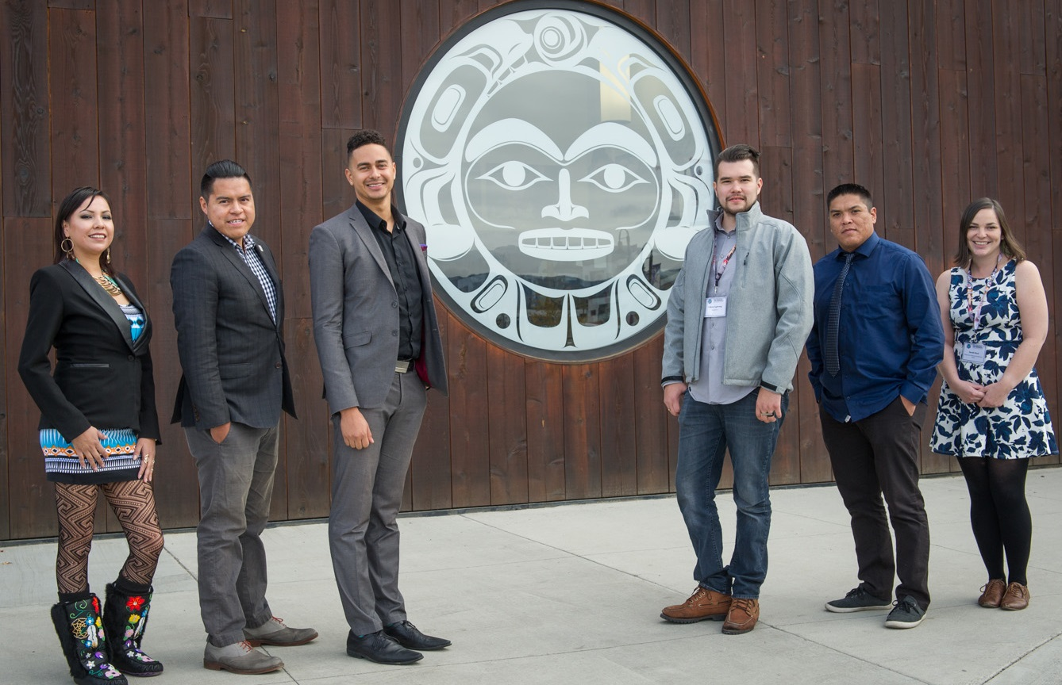
23rd Annual National Conference & AGM
12th Annual National Youth Panel
L-R: Chantel Wilson, Carl Archie, Robert Beamish, Dakota Lightning, Jordan Peterson, & Sarah Wood.
Credit: Archbould Photography

Slide 21
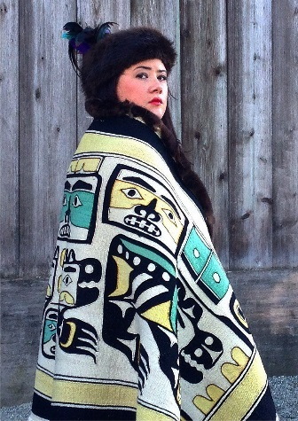

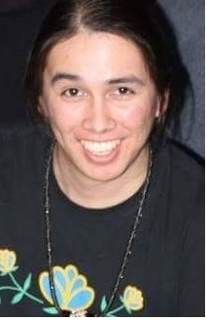
2016 NIEEF Scholarship Recipients
Kluane Adamek
Kluane First Nation, YT
Simon Fraser University
MBA, Aboriginal Business & Leadership
Natasha Brooks
Cowichan Tribes, BC
Vancouver Island University - Masters of Business Administration / Master of Science in International Management
Quinn Meawasige
Serpent River First Nation, ON
Algoma University - Community Economic and Social Development

Slide 22
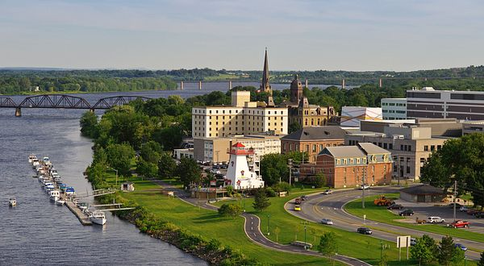
24th Annual National Conference & AGM
October 2017
Fredericton, New Brunswick

Slide 23
Excellence in Aboriginal Economic Development

Slide 24
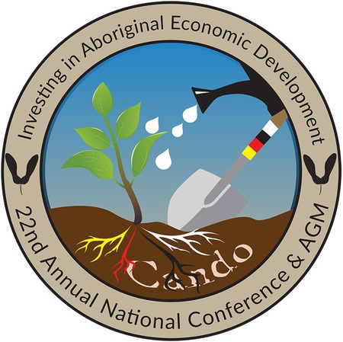

The Impact of CANDO and the Aboriginal EDO Certification Program

Slide 25


Definitions…
Business Development: includes a number of techniques designed to create and grow an economic enterprise. Business development involves evaluating a business and then realizing its full potential, using such tools as marketing, sales, information management and customer service. For a sound company to be able to withstand competitors, detailed strategies for business growth and business development have to be an ongoing process which may involve financial, legal and advertising skills. Creativity to meet new an unforeseen challenges is necessary to keep a business on a path of sustainable growth.
20

Slide 26
Definitions…
Economic Development: refers to the deliberate effort to improve the economy of a specified geographic area, which can be as large as an entire nation-state or as limited as a city neighborhood. Stating that it is a process, the source points out that it's a challenge put measures in place that would indicate whether or to what degree improvement take place in a location. The source notes that economic development may be an activity specifically undertaken but that ... the same intended consequences might also take place spontaneously, without any deliberate efforts to achieve them ... and attributes the existence of the practice of economic development to the observation that what locations desire don't often spontaneously appear.
Community Economic Development: is a process by which communities can initiate and generate their own solutions to their common economic problems and thereby build long-term community capacity and foster the integration of economic, social and environmental objectives.
21

Slide 27
Definitions…
Aboriginal Community Economic Development: is a process where Aboriginal communities are working to reclaim control over their communities and lives, to overcome generations of poverty and dependence, to develop vigorous economies that fit their cultures and circumstances, to build effective governments, to solve difficult social problems, and to balance cultural integrity with change.
Traditional Aboriginal Community Economic Development: is based on a process where Aboriginal communities build effective governments and communities, solve social problems, and develop economies based on traditional practices, values, land use and pursuits. This may include an economy based on harvesting (hunting and gathering) animals, plants and fish. These types of activities have sustained many Aboriginal cultures for thousands of years and are a foundation for culture and traditional knowledge in the Aboriginal community.
22

Slide 28
Where Does Your Community Fit?
Community Development Matrix
Where Does Your Community Fit?
Traditional
Aboriginal Community Economic
Development
Gift Lake Metis Settlement
www.msgc.ca
Aboriginal
Community Economic Development
Osoyoos
Indian Band
www.oib.ca
Community
Economic
Development
Within Your Community
Economic Development
Business
Development
TCIG
www.tcig.biz
Business
Development
Economic Development
Community
Economic
Development
Aboriginal
Community Economic Development
Traditional
Aboriginal Community Economic
Development
Outside Your Community
23

Slide 29
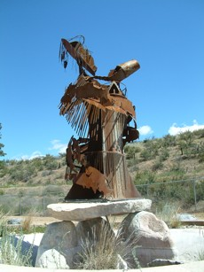
Osoyoos Indian Band
The Osoyoos Indian Band has a strong vision for its future and for the region. OIB's land base consists of over 32,000 acres of British Columbia's most beautiful land with stunning vistas, rich agricultural lands, and some of the last large tracts of desert lands left in Canada. As part of the Okanagan Nation, these are a strong, independent and proud people with a rich heritage. The Osoyoos Indian Band has always been progressive; from the early years of ranching, trading and small farms the people have continued to change with the times. Now, huge vineyards sprawl across these lands, businesses are being invited to call this home and the people have become business oriented. The Band manages businesses with annual budgets in excess of $l7 million dollars and administers its own health, social, educational and municipal services.
The Osoyoos Indian Band Membership is approximately 450, with the majority of the Band Members living on the Osoyoos Indian Reservation. Improvements and modernization are everywhere. During recent years new home construction on the reserve has been swift with growth matching the rest of the South Okanagan each year.
25
www.oib.ca

Slide 30

VISION ~To contribute to First Nations’ SELF-SUFFICIENCY by generating WEALTH and being a major player in the Canadian and international economies.
MISSION ~We will achieve our vision by making LONG-TERM strategic investments that generate wealth,EMPLOYMENT and a SUSTAINABLE capital fund.
In 1990, the 7 Tribal Councils in Manitoba, representing 55 First Nation communities and over 100,000 people, combined resources to establish themselves in the corporate business community. Each Tribal Council made an initial investment of $25,000 to form Tribal Councils Investment Group of Manitoba Ltd. (TCIG). A head office was set up at Opaskwayak Cree Nation and a corporate office was opened in Winnipeg, Manitoba.
The mandate of TCIG is to act as the investment arm of its Tribal Council shareholders combining the investment capacity of the individual Tribal Councils.
TCIG’s key objectives are to:
  Achieve double-digit growth.
  Be financially independent.
  Become a credible and prominent member of the Manitoba
  business community.
TCIG has far exceeded its initial objectives and has proven to be an excellent investment for its 7 Tribal Council shareholders. The financial returns generated by TCIG’s family group of companies have far surpassed all forecasts and TCIG has become a prominent and respected member of the Manitoba and Canadian business communities.
26
www.tcig.biz

Slide 31
CANDO Strategic Plan 2011 - 2016
Performance measurement – a strategic priority of Cando
Why? Creates ‘Learning‘ to optimize performance
The Evidence Network (TEN), an independent 3rd party, was engaged to conduct a phased impact assessment
Phase 1 (completed):
  Impact of Cando and the Aboriginal Economic Developers Certification Program on EDOs
Phase 2 (winter 2015 – 2016):
  Impact of EDOs on companies and communities

Slide 32
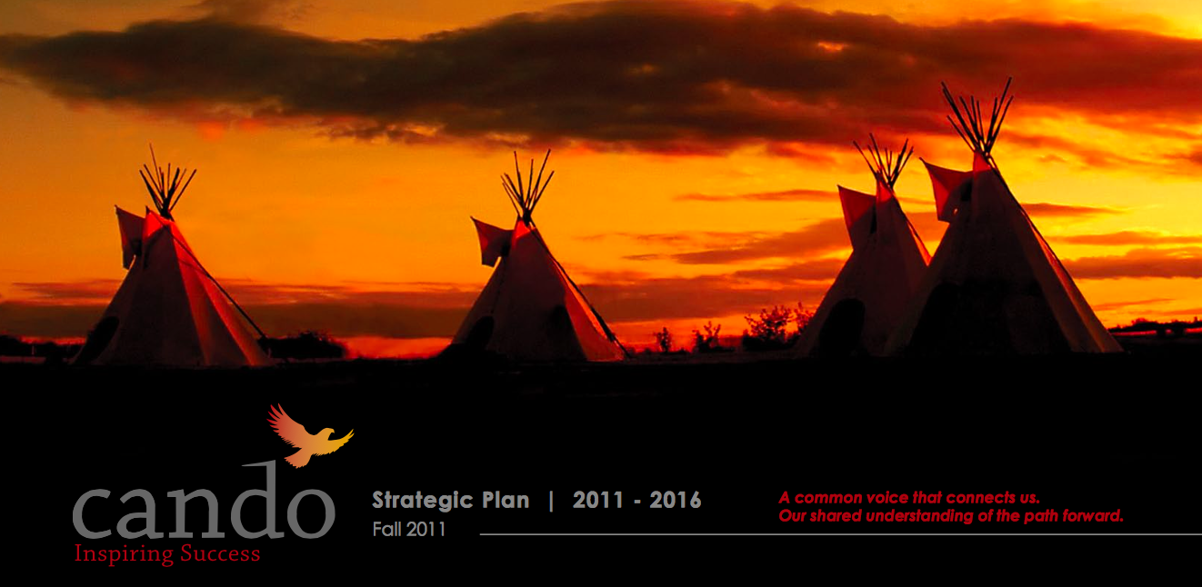
Methodology
Cando and the EDO
Certification Program
EDOs
Impact on
EDOs
Performance
Mission
Impact on
EDOs Capabilities
Services

Slide 33
Survey of EDOs
Methodology was implemented through a web-based survey sent to 1,101 EDOs
Respondents were classified into two groups:
  223 Cando members, conference participants
  79 EDOs that participated in the Certification Program
Survey focused on:
  Cando services and their use
  Attributed impact on EDO knowledge and capabilities
  Attributed impact on EDO performance in communities

Slide 34
Respondent Demographics - EDOs First Engagement
61% of Cando respondents first engaged with Cando in 2010 or later
28% of Certification Program respondents first participated in the Certification Program in 2001 or earlier.

Slide 35
EDO Educational Level
55% of all respondents report that they possess at least a bachelor’s degree
31% of those employed in Canada in 2011 attained university credentials

Slide 36
Community Development Stage
38% of all respondents report that their communities are in, or beyond, the Integration stage of community development.
Notes:
35% of Cando respondents, and 44% of Certification Program respondents report that their communities are in, or beyond, the integration stage of community development.
 Learning culture, empowered individuals and organizations, community easily comes together and makes decisions
 Innovation stage, sense of community entrepreneurship, community lacks desire to constantly learn and improve
 Integration stage, cooperation among stakeholders, shared decision-making, community lacks a culture of innovation and entrepreneurship
 Vision stage, ability to undertake and follow through on strategic plans, community lacks recognition of the need for stakeholder cooperation
 Strategic stage, community is able to make strategic decisions but not necessarily able to undertake strategic planning
 Simple planning stage, community is able to conduct simple planning exercises, some long term visioning takes place
 Coping stage, community focuses on planning for day-to-day and infrastructure-related needs
 Paralysis or unfocused stage, community is without a plan or direction, community lacks shared vision
 Non-cooperation stage, community can gather together but cannot work together due to deep-seated divisions in values
 Conflict stage, community is unable to come together, intense verbal and physical conflict

Slide 37
Cando Professional Training – Aboriginal Context
61% of all respondents indicated they found the Aboriginal context expertise of the trainer, training material, or training services provided through Cando ‘very good’ or ‘excellent’ during their involvement in Cando’s Professional development training.

Slide 38
Certification Program – Aboriginal Context
50% of respondents indicated they found the Aboriginal context expertise of the trainer or material ‘very good’ or ‘excellent’ during their involvement in the Certification Program.

Slide 39
Cando Professional Training – General
56% of all respondents indicated they found the General economic development expertise of the trainer, training material, or training services provided through Cando ‘very good’ or ‘excellent’ during their involvement in Cando’s Professional development training.

Slide 40
Certification Program – General Economic Dev.
60% of all respondents respondents indicated they found the General economic development expertise of the trainer or material ‘very good’ or ‘excellent’ during their involvement in the Certification Program.

Slide 41
Cando Professional Training – Benefits
88% of all respondents attributed positive impact to Cando’s Professional development training on new ideas for how to enhance their community’s economic development strategy.

Slide 42
Certification Program – Benefits
90% of all respondents, and 89% of PAED-certified respondents attributed positive impact to their certification training on new ideas for how to enhance their community’s economic development strategy.

Slide 43
Impact on EDO Capabilities
84% report positive impact
82%
44%
78%
71%
Notes:
Network linkages (83% of Cando respondents report positive impact) (39% ‘some’, 23% ‘significant’, and 21% ‘very significant’)
Network linkages (89% of Certification Program respondents report positive impact) (32% ‘some’, 38% ‘significant’, and 19% ‘very significant’)
Aboriginal knowledge (79% of Cando respondents report positive impact)(40% ‘some’, 27% ‘significant’, and 12% ‘very significant’)
Aboriginal knowledge (88% of Certification Program respondents report positive impact) (40% ‘some’, 27% ‘significant’, and 21% ‘very significant’)
Strategic capabilities (73% of Cando respondents report positive impact) (46% ‘some’, 18% ‘significant’, and 9% ‘very significant’)
Strategic capabilities (88% of Certification Program respondents report positive impact) (37% ‘some’, 35% ‘significant’, and 16% ‘very significant’)
Cando respondents whose communities are in the Learning culture, Innovation, or Integration stage of community development attribute greater average impact to Cando on their knowledge and capabilities than those whose communities are in, or below, the Vision stage of community development, based on the Communities Matrix (significant at the 99% confidence level).
Certification Program respondents whose communities are in the Learning culture, Innovation, or Integration stage of community development attribute greater average impact to the Certification Program on their knowledge and capabilities than those whose communities are in the Vision, Strategic, or Simple planning stage of community development, based on the Communities Matrix (significant at the 99% confidence level).

Slide 44
Impact on EDO Performance
63% report positive impact
73%
Notes:
Investments received (49% of Cando respondents report positive impact) (22% ‘some’, 22% ‘significant’, and 5% ‘very significant’)
Investments received (85% of Certification Program respondents report positive impact) (31% ‘some’, 39% ‘significant’, and 15% ‘very significant’)
Community engagement (64% of Cando respondents report positive impact) (40% ‘some’, 22% ‘significant’, and 2% ‘very significant’)
Community engagement (89% of Certification Program respondents report positive impact) (46% ‘some’, 32% ‘significant’, and 11% ‘very significant’)
Cando respondents whose communities are in the Learning culture, Innovation, Integration, Vision, Strategic, or Simple planning stage of community development attribute greater average impact to Cando on their performance than those whose communities are in, or below, the Coping stage of community development, based on the Communities Matrix (significant at the 99% confidence level).
Certification Program respondents whose communities are in the Learning culture, Innovation, Integration, Vision, Strategic, or Simple planning stage of community development attribute greater average impact to the Certification Program on their performance than those whose communities are in, or below, the Coping stage of community development, based on the Communities Matrix (significant at least at the 95% confidence level).

Slide 45
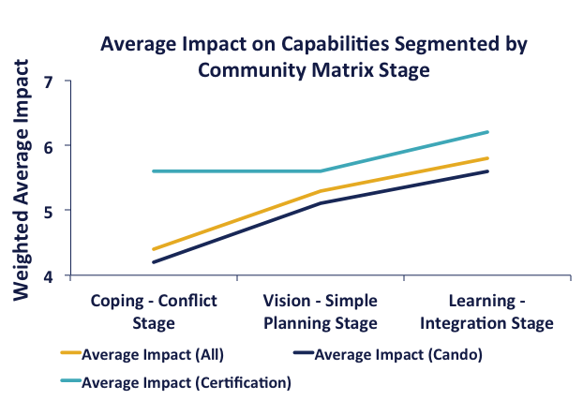
Impact by Community Development Stage
The average impact reported by EDOs on their knowledge and capabilities, and on their performance, increases with increasing community development stage

Slide 46
Networking Opportunities Provided by Cando
The average impact reported by EDOs on their knowledge and capabilities, and on their performance, increases as the degree of use of Cando’s Networking opportunities increases.

Slide 47
Professional Training Provided by Cando
The average impact reported by EDOs on their knowledge and capabilities, and on their performance, increases as the degree of use of Cando’s Professional development training increases.

Slide 48
Opportunity for Improvement
Professional Development Training
79% of the respondents that used these services reported being satisfied or very satisfied with the training.
Only 55% of respondents reported having used the Professional development training services provided by Cando
Notes:
To increase their overall impact on EDOs Cando could increase awareness of, and participation in, their PD training programs.

Slide 49
Opportunity for Improvement
Community Business Revenues
The average attributed impact trends upward as change in community revenues increases.
But, only 41% of respondents reported an increase in Community revenues, and only 55% of respondents attributed positive impact
Notes:
Overall the impact of Cando / Certification Program on respondents’ ability to raise capital is low (44% report positive impact), which may explain why community revenues performance is low. Additional training and increased emphasis on helping EDOs secure funds for their communities may help to increase the overall socio-economic position of the communities.

Slide 50
Summary
Cando is fulfilling its mission to build capacity through EDOs
The quality and benefits of professional development training are evident in the findings
Generally, positive impact is attributed by EDOs to both Cando and the Certification program
  Over 80% of survey respondents attribute positive impact on their ability to network, on their aboriginal knowledge, and their strategic capabilities
Increasing the use of Cando’s services, especially those associated with the practical aspects of economic development, offers promise for even greater impact.

